Slide 1
DESIGN OF STEEL ROOF TRUSSES

Slide 2
Roof Trusses
Trusses are triangular frame works, consisting of axially loaded members
They are more efficient in resisting external loads as the cross section of all the members are nearly uniformly stressed.
They are extensively used for larger spans

Slide 3
Applications
Trusses are used in
Roofs of single storey industrial buildings
long span floors and roofs of multistory buildings, to resist gravity loads.
Trusses are also used in walls and horizontal planes of industrial buildings to resist lateral loads and to provide lateral stability.

Slide 4
Analysis of Trusses
Truss members are regarded as being pinned joints.
They are assumed to be joined together so as to transfer only the axial forces and not moments and shears from one member to the adjacent members
The loads are assumed to be acting only at the nodes of the trusses.

Slide 5
Analysis of Trusses
The trusses may be provided over
a single span, simply supported over the two end supports, in which case they are usually statically determinate.
Such trusses can be analyzed manually by
method of joints
method of sections.
Computer programs are also available for the analysis of trusses.

Slide 6
Analysis of Trusses
From the analysis based on pinned joint assumption, we can get the axial forces in the different members of the trusses are found.
In actual design, the members of the trusses are joined together by more than one bolt or by welding, either directly or through larger size end gussets.

Slide 7
Analysis of Trusses
Further, some of the members, particularly chord members, may be continuous over many nodes. Generally such joints enforce not only compatibility of translation but also compatibility of rotation of members meeting at the joint.

Slide 8
Analysis of Trusses
As a result, the members of the trusses experience bending moment in addition to axial force. This may not be negligible, particularly at the eaves points of pitched roof trusses, where the depth is small and in trusses with members having a smaller slenderness ratio.

Slide 9
Analysis of Trusses
Further, the loads may be applied in between the nodes of the trusses, causing bending of the members. Such stresses are referred to as secondary stresses.
The secondary bending stresses can be caused also by the eccentric connection of members at the joints.

Slide 10
Methods to reduce BM in columns (Knee Bracings)

Slide 11
Analysis of Trusses
The analysis of trusses for the secondary moments and hence the secondary stresses can be carried out by an indeterminate structural analysis, usually using computer software.
The magnitude of the secondary stresses due to joint rigidity depends upon the stiffness of the joint and the stiffness of the members meeting at the joint.

Slide 12
Analysis of Trusses
Secondary stresses in roof trusses may be disregarded if
Slenderness ratio of the chord members is greater than 50 and that of the web members is greater than 100.
The secondary stresses cannot be neglected
When they are induced due to application of loads on members in between nodes and when the members are joined eccentrically.

Slide 13
Analysis of Trusses
Further the secondary stresses due to the rigidity of the joints cannot be disregarded
In the case of bridge trusses, due to the higher stiffness of the members and the effect of secondary stresses on fatigue strength of members.

Slide 14
Materials for Roofing

Slide 15
Fastenings for Sheeting

Slide 16
Side lap Corrugated Sheet

Slide 17
Flat Cum Corrugated Sheets

Slide 18
Types of Roof Truss
Pitched roof trusses
Parallel chord trusses
Trapezoidal trusses

Slide 19
Pitched Roof Trusses
Most common types of roof trusses
Top chord is provided with a slope in order to facilitate natural drainage of rainwater and clearance of dust/snow accumulation.
The typical span to maximum depth ratios
of pitched roof trusses are in the range of 4
to 8, the larger ratio being economical in
longer spans.

Slide 20
Pitched Roof Trusses
These trusses have a greater depth at the mid-span. Due to this even though the overall bending effect is larger at mid-span, the chord member and web member stresses are smaller closer to the mid-span and larger closer to the supports.

Slide 21
King Post Truss

Slide 22
Queen Post Truss

Slide 23
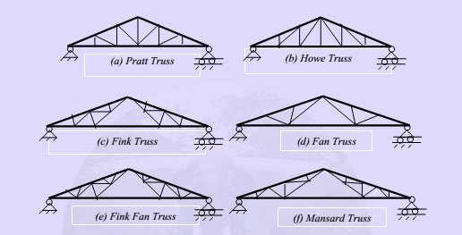

Slide 24
Pratt Truss (6-30m)
In Pratt trusses [Fig. (a)] web members are arranged in such a way that under gravity load the longer diagonal members are under tension and the shorter vertical members experience compression.
This allows for efficient design, since the short members are under compression.
However, the wind uplift may cause reversal of stresses in these members and nullify this benefit.

Slide 25
Howe Truss (6-10m)
The converse of the Pratt is the Howe truss [Fig. (b)]. This is commonly used in light roofing so that the longer diagonals experience tension under reversal of stresses due to wind load.

Slide 26
Fink Trusses(up to 10m)
Fink trusses [Fig. (c)] are used for longer spans having high pitch roof,
The web members in such truss are sub-divided to obtain shorter members.

Slide 27
Fan Trusses (10-15m)
Fan trusses [Fig. (d)] are used when the rafter members of the roof trusses have to be sub-divided into odd number of panels.

Slide 28
Fink Fan Truss (20-30m)
A combination of fink and fan [Fig. (e)] can also be used to some advantage in some specific situations requiring appropriate number of panels.

Slide 29
Mansard Trusses(20-30m)
Mansard trusses [Fig. (f)] are variation of fink trusses, which have shorter leading diagonals even in very long span trusses, unlike the fink and fan type trusses.

Slide 30
Economical Span
The economical span lengths of the pitched roof trusses, excluding the Mansard trusses, range from 6 m to 12 m.
The Mansard trusses can be used in the span ranges of 12 m to 30 m.

Slide 31
Parallel Chord Trusses

Slide 32
Parallel Chord Trusses
The parallel chord trusses are used to support
North Light roof trusses
intermediate span bridges
pre-fabricated floor joists, beams and girders in multi- storey buildings
Warren configuration is frequently used

Slide 33
Parallel Chord Trusses
The advantage of parallel chord trusses is that they use webs of the same lengths and thus reduce fabrication costs for very long spans.
Modified Warren is used with additional verticals, introduced in order to reduce the unsupported length of compression chord members.
The saw tooth north light roofing systems use parallel chord lattice girders to support the north light trusses and transfer the load to the end columns.

Slide 34
Parallel Chord Trusses
The economical span to depth ratio is in the range of 12 to 24.
The total span is subdivided into a number of panels such that the individual panel lengths are appropriate (6m to 9 m) for the stringer beams, and the inclination of the web members are around 45 degrees.
In the case of very deep trusses it may become necessary to use K and diamond patterns for web members to achieve appropriate inclination of the web members.

Slide 35
Trapezoidal Trusses
In case of very long span pitched roof, trusses having trapezoidal configuration, with depth at the ends are used [Fig. (a)]. This configuration reduces the axial forces in the chord members adjacent to the supports. Secondary bending effects in these members are also reduced.
The trapezoidal configurations [Fig. (b)] having the sloping bottom chord can be economical in very long span trusses (spans > 30 m), since they tend to reduce the web member length and the chord members tend to have nearly constant forces over the span length.

Slide 36
Trapezoidal Trusses

Slide 37
Common types of roof trusses

Slide 38
Common types of roof trusses

Slide 39
Roof types

Slide 42
Industrial buildings with different spans

Slide 43
Structural framing for an industrial building

Slide 44
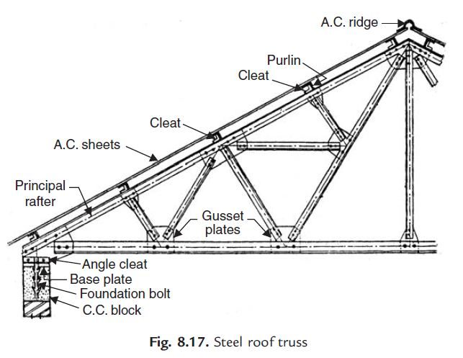

Slide 48
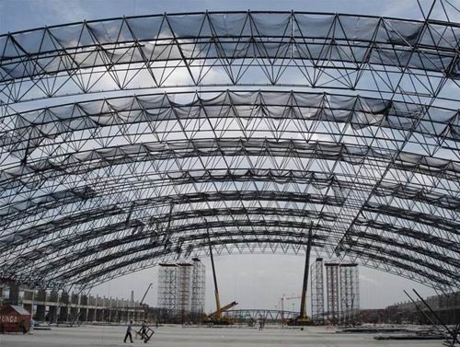

Slide 50
Truss Members

Slide 51
Truss members
LIGHTER LOADS : Rolled steel angles, Tee sections, Hollow circular / rectangular structural tubes [Fig. (a)].
HEAVY LOADS : heavier rolled steel sections, such as channels, I sections are used [Fig. (b)].
LONG SPAN BRIDGE TRUSSES : Built-up sections
Members built-up using I-Sections, channels, angles and plates [Fig. c)]

Slide 52
Truss Connections
Members of trusses can be joined by
Riveting,
Bolting
Welding.
Due to involved procedure and highly skilled labour requirement, riveting is not common these days.
High strength friction grip (HSFG) bolting and welding have become more common.

Slide 53
Truss Connections
Shorter span trusses are usually fabricated in shops and can be completely welded and transported to site as one unit.
Longer span trusses can be prefabricated in segments by welding in shop. These segments can be assembled by bolting or welding at site.

Slide 54
Truss Connections
Truss connections form a high proportion of the total truss cost. Therefore it may not always be economical to select member sections, which are efficient but cannot be connected economically.
Trusses may be single plane trusses in which the members are connected on the same side of the gusset plates or double plane trusses in which the members are connected on both sides of the gusset plates.

Slide 55
Truss Connections
It may not always be possible to design connection in which the centroidal axes of the member sections are coincident
Small eccentricities may be unavoidable and the gusset plates should be strong enough to resist or transmit forces arising in such cases without buckling
The bolts should also be designed to resist moments arising due to in-plane eccentricities. If out-of-plane instability is foreseen, use splice plates for continuity of out-of-plane stiffness.

Slide 56
Truss Connections

Slide 57
Gusset Plate
The size, shape and the thickness of the gusset plate depend upon the size of the member being joined, number and size of bolt or length of weld required, and the force to be transmitted.
The thickness of the gusset is in the range of 8 mm to 12 mm in the case of roof trusses and it can be as high as 22 mm in the case of bridge trusses.

Slide 58
Gusset Plate
The design of gussets is usually by thumb rule.
In short span (8 – 12 m) roof trusses, the member forces are smaller, hence the thickness of gussets are lesser (6 or 8 mm)
For longer span lengths (> 30 m) the thickness of gussets are larger (12 mm).

Slide 59
Cross Braced Lattice Wind Girder

Slide 60
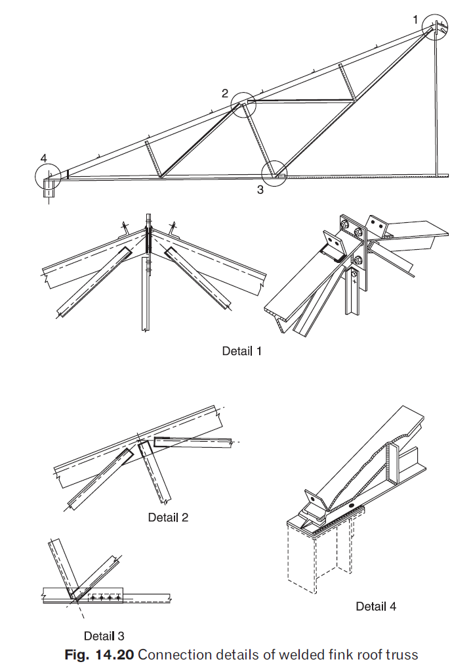
Welded connections

Slide 61
Bolted Connections

Slide 62
Connection of bolted lattice girder

Slide 63
Open web steel joints

Slide 65
Three dimensional lattice girder

Slide 66
Purlins
Purlins are subjected to
Bending about major axis due to the components of DL, LL & WL normal to the axis of purlin section
Bending about minor axis due to the components of DL & LL normal to the axis of purlin section

Slide 67
Purlins
Designed in accordance with the requirements of encased beams
Designed as continuous beams with laterally supported comp. flange-connections in sheetings
All working loads should be multiplies with suitable partial load factors
BM calculated by plastic analysis
For calculation of flexural strength, shear strength should also be checked

Slide 68
Purlins
Limiting deflection
1/150 for elastic cladding
(GI Sheets)
1/180 for Brittle cladding
(AC Sheets)

Slide 69
Design of Trusses
Compression members of the trusses have to be checked for their buckling strength about the critical axis of the member. This buckling may be in plane or out-of-plane of the truss or about an oblique axis as in the case of single angle sections.
All the members of a roof truss usually do not reach their limit, members usually have certain rigidity, depending on the restraint to the members under compression by the adjacent members and the rigidity of the joint.
Effective length of the member for calculating the buckling strength may be less than the c/c length of the joints.

Slide 70
Design of Trusses
The design codes suggest an effective length factor between 0.7 and 1.0 for the in-plane buckling of the member depending upon this restraint and 1.0 for the out of plane buckling.

Slide 71
Design of Trusses
A member under tension due to gravity loads (dead and live loads) may experience stress reversal into compression due to dead load and wind load combination.
Similarly the web members of the bridge truss may undergo stress reversal during the passage of the moving loads on the deck. Such stress reversals and instability due to the stress reversal should be considered in design.

Slide 72
Economy of Trusses
Trusses consume a lot less material compared to beams to span the same length and transfer moderate to heavy loads. However, the labour requirement for fabrication and erection of trusses is higher and hence the relative economy is dictated by different factors.
In India these considerations are likely to favour the trusses even more because of the lower labour cost.

Slide 73
Economy of Trusses
In order to fully utilize the economy of the trusses the designers should ascertain the following:
• Method of fabrication and erection to be followed, facility for shop fabrication available, field assembly facilities.
Preferred practices and past experience.
Availability of materials and sections to be used in fabrication.

Slide 74
Economy of Trusses
Erection technique to be followed and erection stresses.
Method of connection preferred by the contractor and client (bolting, welding or riveting).
Choice of as rolled or fabricated sections.
Simple design with maximum repetition and minimum inventory of material.

Slide 75
Economy of Trusses
T=2P+R
T - Cost of the truss
P - Cost of Purlin
R - Roof covering

Slide 76
Inputs Required for Truss Design
Truss Type. Determines whether there will be storage or living space. Also defines architectural details such as soffit, overhang, fascia heights
Location. Determines the building codes. loads that apply. In some areas, seismic requirements may drive the design and cost of the truss. In some other areas, it is wind that drives the design.
Open Category. Determines the proportion of openings (doors, windows, etc) to the overall wall area. Door and window openings can increase the pressure inside a structure during wind loading conditions.

Slide 77
Inputs Required for Truss Design
Wind Exposure Category. Determines the amount of wind the structure will be susceptible to.
Building Category. Determines the type of structure such as a hospital, school, residential, etc.
Span(s). Determined by the building plans. If special requirements are needed, they need to be noted on the plans.
Desired Roof Slope (Pitch). Pitch influences many of the design parameters and consequently has an impact on the overall truss weight.

Slide 78
Inputs Required for Truss Design
Building Plans. Building plans provide the truss designer/manufacturer valuable information on the wall types, thicknesses, spans, chord slopes, etc.

Slide 79
Example Problem

Slide 80
An Industrial building of plan 15m×30m is to be constructed Using plastic analysis, analyse and design the single span portal frame with gabled roof. The frame has a span of 15 m, the column height is 6m and the rafter rise is 3 m and the frames are spaced at 5 m centre-to-centre. purlins are provided over the frames at 2.7 m c/c and support AC sheets. The dead load of the roof system including sheets, purlins and fixtures is 0.4 KN/m² and the live load is 0.52 kN/m²
.

Slide 82
Given data
Size of industrial building :15m×30m
Span of the truss w = 15m
Spacing of roof truss S = 5m
Dead load on the roof DL = 0.4 kN/m²
(including sheets, purlins and fixtures}
live load on the truss LL = 0.52 kN/m²
Spacing of Purlins =2.7.c/c
column height h = 6m
Central rise of the Truss R = 3 m
Roof covering : AC sheets

Slide 83
Load Calculations
Dead Load of roof is given as 0.4 kN/m²
Dead load/m run on rafter = 0.4 x 5
= 2.0 kN/m
Live Load given as 0.52 kN/m²
Live load/m run on rafter = 0.52 x 5
= 2.6 kN/m
LL as per IS 875 Part 2 1987
Table 2, Pg. 14

Slide 84
Wind Load
Design wind speed, V_{z} = k₁ k₂ k₃ V_{b} (Cl. 5.3 Pg. 8 of IS: 875 - part 3 )
K₁ = Probability factor ( risk coefficient )
K₂ = Terrain, height and structure size factor
K₃ = Topography factor
V_{b} = Basic wind speed (m/s)

Slide 85
From Table 1; IS: 875 (part 3) – 1987
k₁ = 1.0 (risk coefficient for 50 years of design life)
From Table 2; IS: 875 (part 3) – 1987
k₂ = 0.8 (assuming terrain category 4)
k₃ = 1.0 (topography factor)

Slide 86
Assuming the building is situated in Chennai, the basic wind speed is 50 m/sec
(APPENDIX A Pg. 53)
Design wind speed, V_{z} = k₁ k₂ k₃ V_{b}
V_{z} = 1 x 0.8 x1 x 50
= 40 m/sec
Design wind pressure P_{d} = 0.6x V_{z}²
= 0.6 x (40)²
= 0.96 kN/m²

Slide 87
Wind Load on individual surfaces
The wind load, WL acting normal to the individual surfaces is given by
WL = (C_{pe} – C_{pi} ) A.P_{d}
Where
C_{pe} = External pressure coefficient
C_{pi} = Internal pressure- coefficient
A = Surface area of structural or cladding unit
P_{d} = Design wind pressure.

Slide 88
Internal Pressure Coefficients
Internal air pressure in a building depends upon the degree of permeability of cladding to the flow of air. The internal air pressure may be positive or negative depending on the direction of flow of air in relation to openings in the buildings.
In the case of buildings where the claddings permit the flow of air with openings not more than about 5 percent of the wall area but where there are no large openings, it is necessary to consider the possibility of the internal pressure being positive or negative.
Two design conditions shall be examined, one with an internal pressure coefficient of +0.2 and another with an internal pressure coefficient of -0.2.

Slide 89
Internal Pressure Coefficients
Assuming buildings with low degree of permeability
C_{pi} = ± 0.2

Slide 90
Calculation of total wind load
(a) For walls
h/w = 6/15 = 0.4
L/w = 30/15 = 2.0
Exposed area of wall per frame @ 5 m c/c
A = 5 x 6 = 30m²
Wind load on wall / frame,
A pd = 30 x 0.96 = 28.8 KN

Slide 91
Total wind load on walls

Slide 92
Total wind load on roofs
Exposed area of each slope of roof, per frame (5m length)
A= 5.(3.0²+7.5²)^{1/2}
= 4 0.4 m²
A.P_{d} = 40.4x0.96
= 38.7 kN

Slide 93
Total wind load on roof

Slide 94
Dead Load
Replacing the distributed dead load of 2kN/m on rafter by equivalent concentrated loads at two intermediate points corresponding to purlin locations on each rafter,
W_{dL} = (2x15)/6
= 5kN

Slide 95
Live load
W_{ll} = (2.57x15)/6
= 6.4 kN
Partial Safety Factors
Load Factors
For dead load, γf = 1.5
For leading live load, γf = 1.5
For accompanying live load, γf = 1.05 Material Safety factor
γm = 1.10

Slide 96
From Table 4. Pg.29 of IS 800:2007
(a) 1.5 (DL + LL)
(b) 1.2 (DL + LL + WL)
(c) 1.5(DL +WL)

Slide 97
Typical Truss Report Parameters
Design loads including dead load, live load, snow and wind loads
Member sizes and strength characteristics
Maximum design deflections
Shop drawings with build instructions

Slide 98
THANK YOU

